Slide 1
Machine Learning Superstore Sales Prediction
Chole
Ching

Slide 2
TABLE OF CONTENTS
01
02
03
Business Question
Data Collection
Preprocessing
04
05
06
Model(s) Creation
Model Evaluation and Comparison
Conclusion and Future Improvements

Slide 3
01
Business Question

Slide 4
Business Objectives
Prediction Sales of Store
60%
Seasonal Sales Pattern
36-51 YEARS
Implication of macro-economic indictors
Based on the historical data of the 45 Walmart stores, and understand the overall growth
Examine the seasonal pattern for better implementing marketing campaigns
Venus has a beautiful name, but it’s hot
Significance of the macro-indicators like CPI, Unemployment rate, Fuel price etc. on the sales figure

Slide 5
02
Data Collection

Slide 6

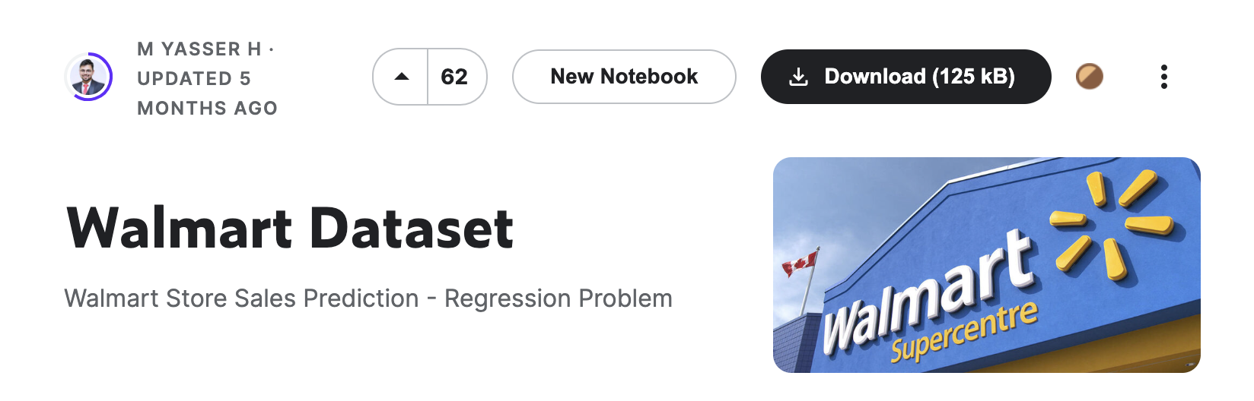
Data Collection
https://www.kaggle.com/datasets/yasserh/walmart-dataset

Slide 7
03
Preprocessing

Slide 8
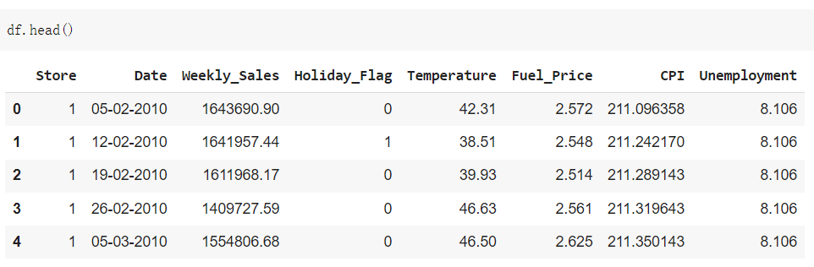
EDA
Original Dataset:
Weekly sales data of :
45 Walmart stores in the US
143 weeks from 2010-02-05 to 2012-10-26.

Slide 9
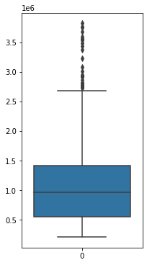
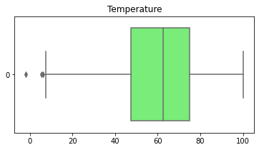
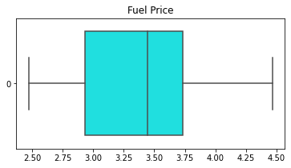
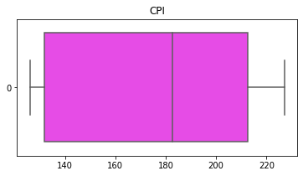
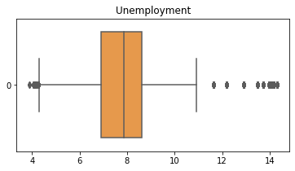
EDA
Univariate Analysis
Weekly Sales
UQ: 1,420,158
Mean: 1,046,964
LQ: 553,350

Slide 10
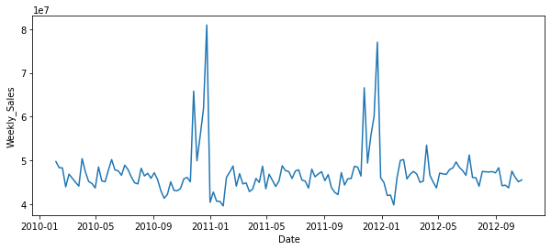
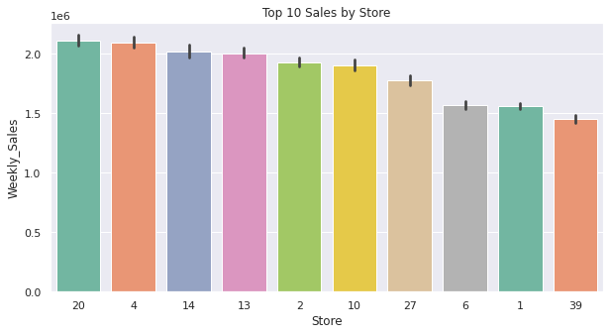
EDA
Bivariate Analysis
Weekly Sales & Date
2 peaks at the end of every year
Thanksgiving and Christmas
Store no. 20 has the highest total sales during 2010-02-05 to 2012-10-26.

Slide 11
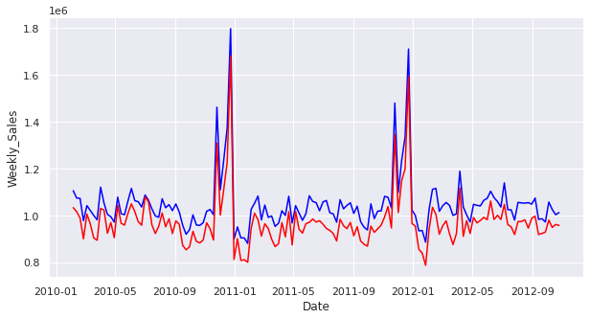
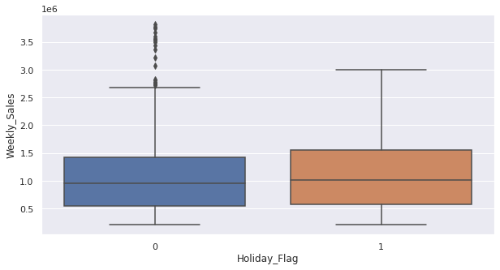
EDA
Bivariate Analysis
Mean (blue line) is higher than median (red line)
indicates that the sales among stores may vary a lot
Holiday weeks have a higher mean but not significant.
Non-holiday weeks have a number of outliers with much higher sales.

Slide 12
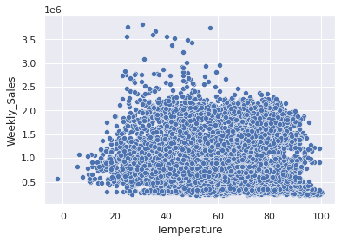
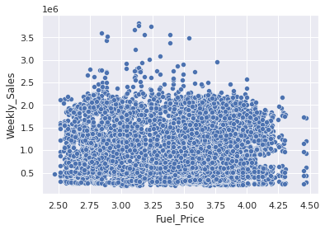
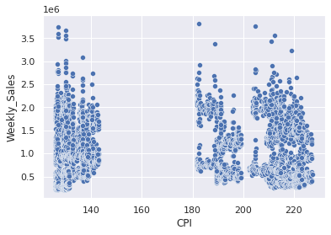
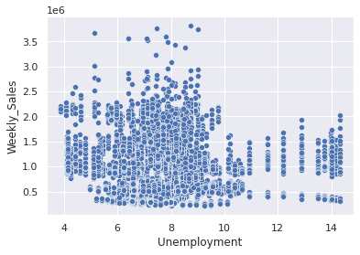
EDA
Bivariate Analysis
All these features show no obvious positive/negative relationship with Weekly Sales

Slide 13
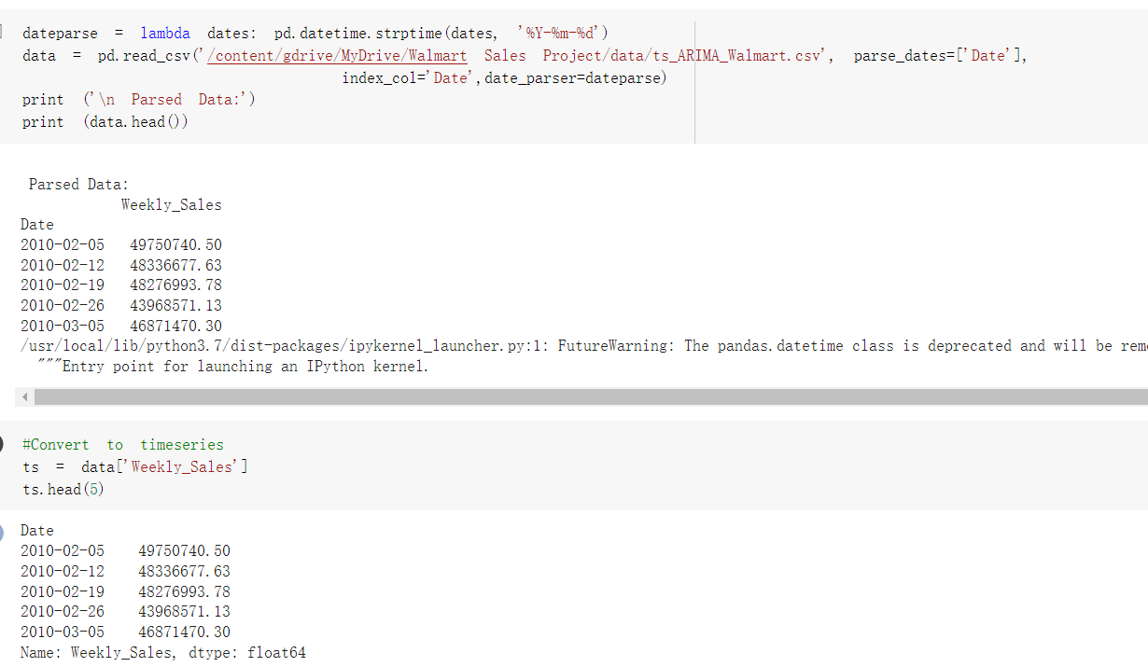
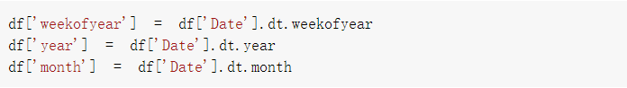
Preprocessing
Time Series Models
Converting ‘Date’ to datetime object
Converting into time series
Regression Models
Converting date to numerical features

Slide 14
04
Model(s) Creation

Slide 15
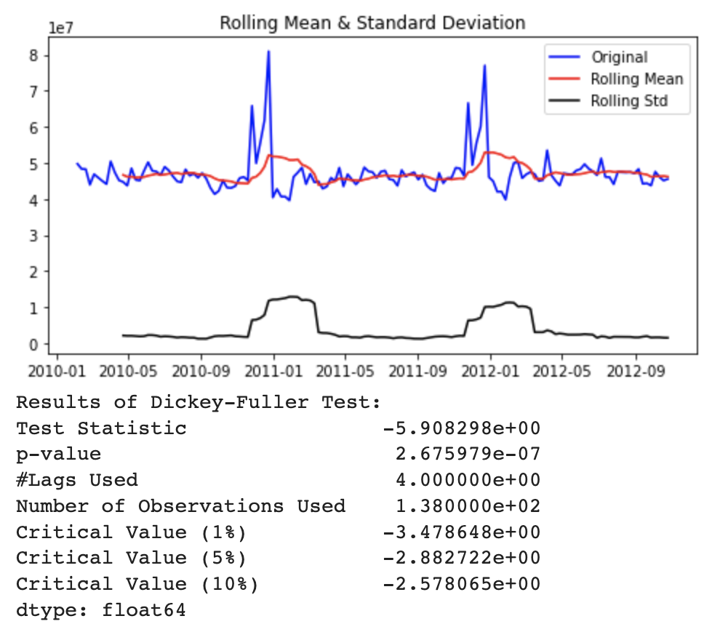

Time Series Algorithms
ARIMA
DF Test for stationarity
p-value = 0.0267e-05
(<0.05, = stationary)

Slide 16
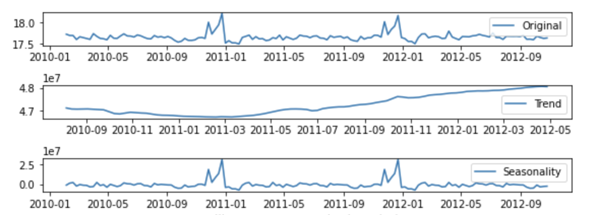
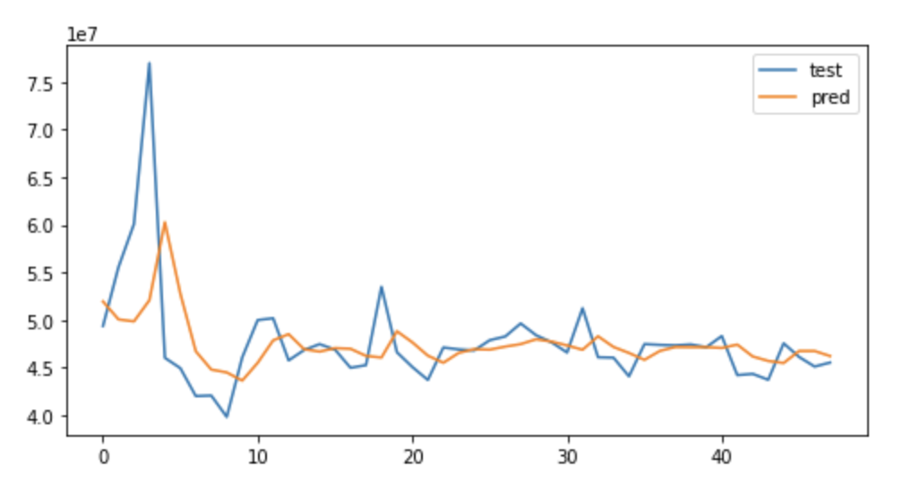
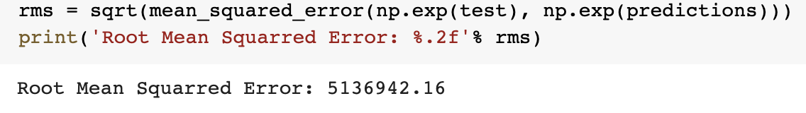
Time Series Algorithms
ARIMA
Notes:
5136942.16

Slide 17
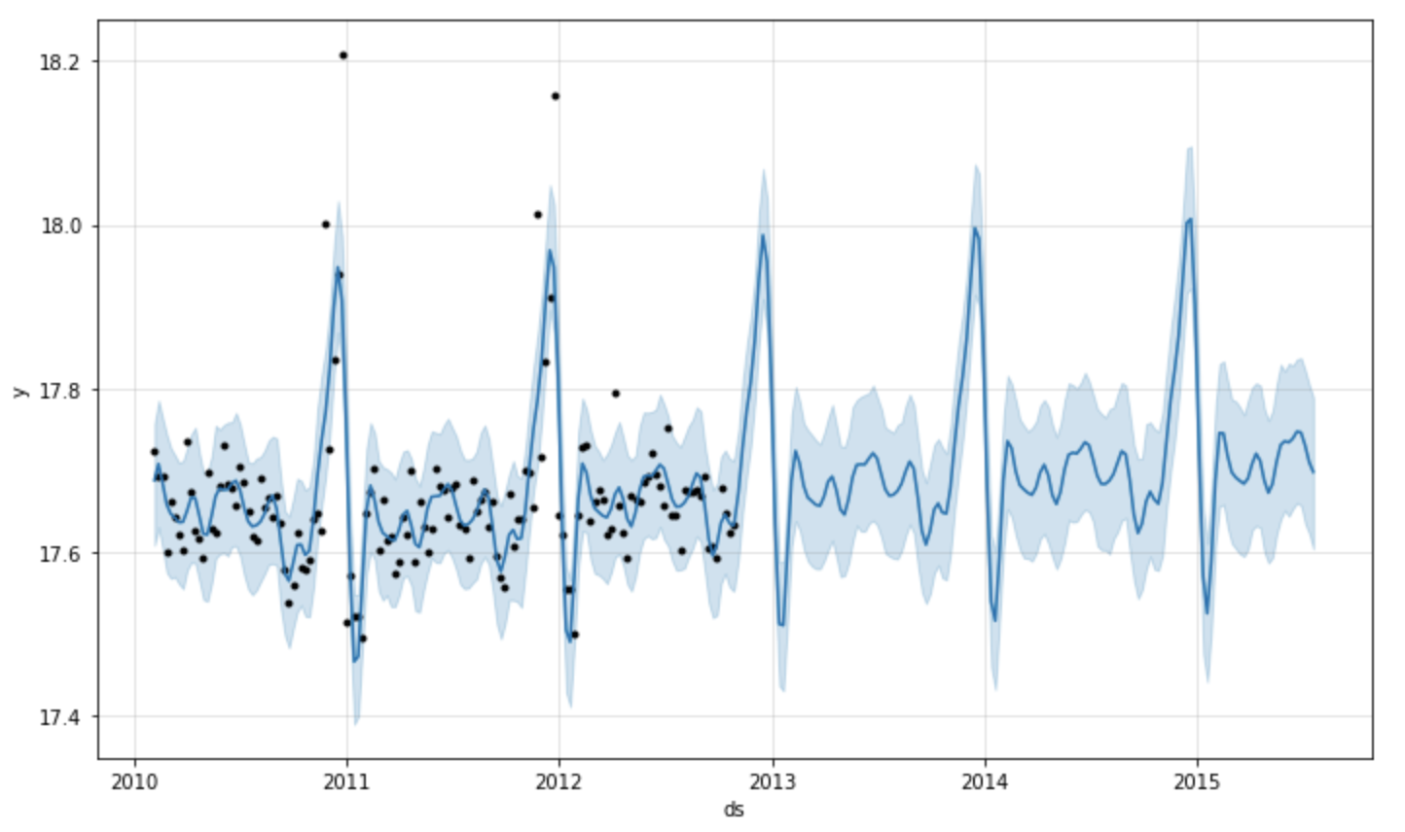
Time Series Models
Facebook Prophet
Univariate Forecasting
Notes:
5136942.16

Slide 18
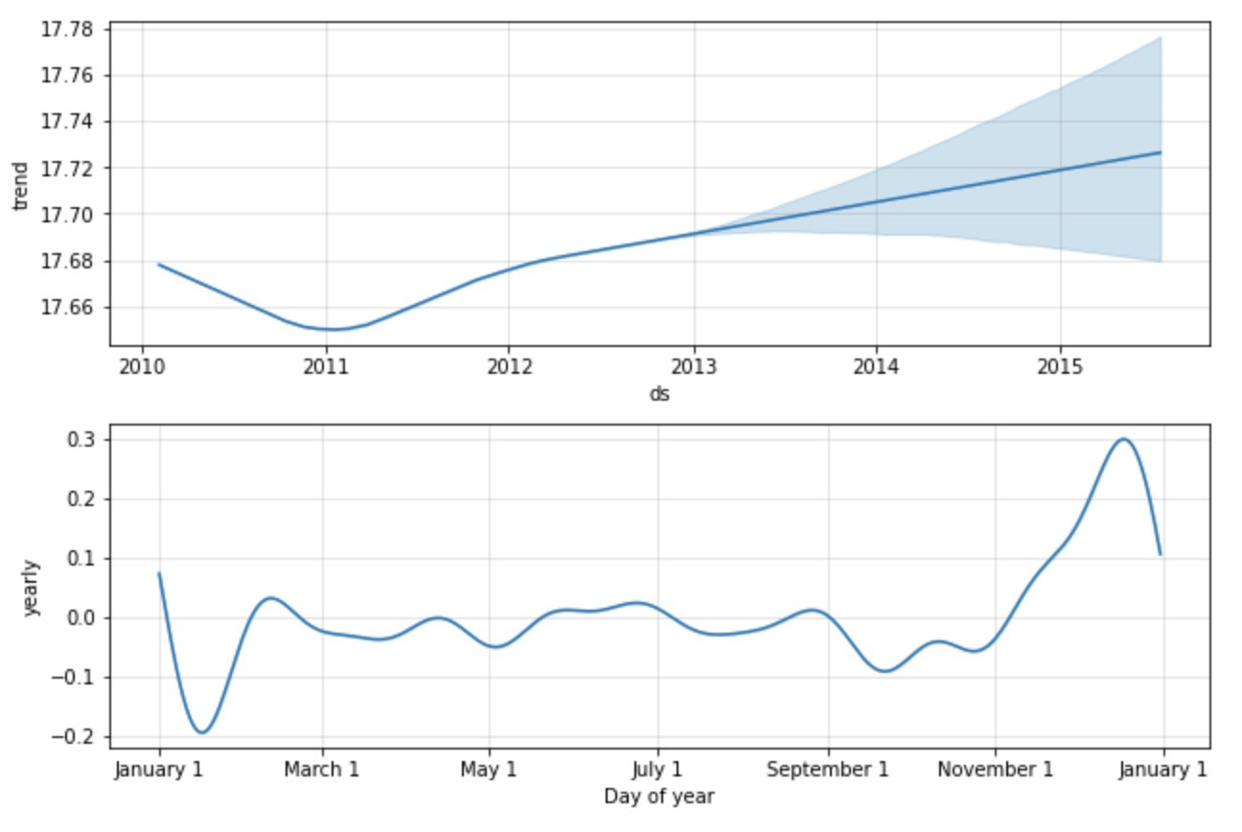
Time Series Models
Facebook Prophet
Univariate Forecasting
RMSE : 3451591.61
Notes:
5136942.16

Slide 19
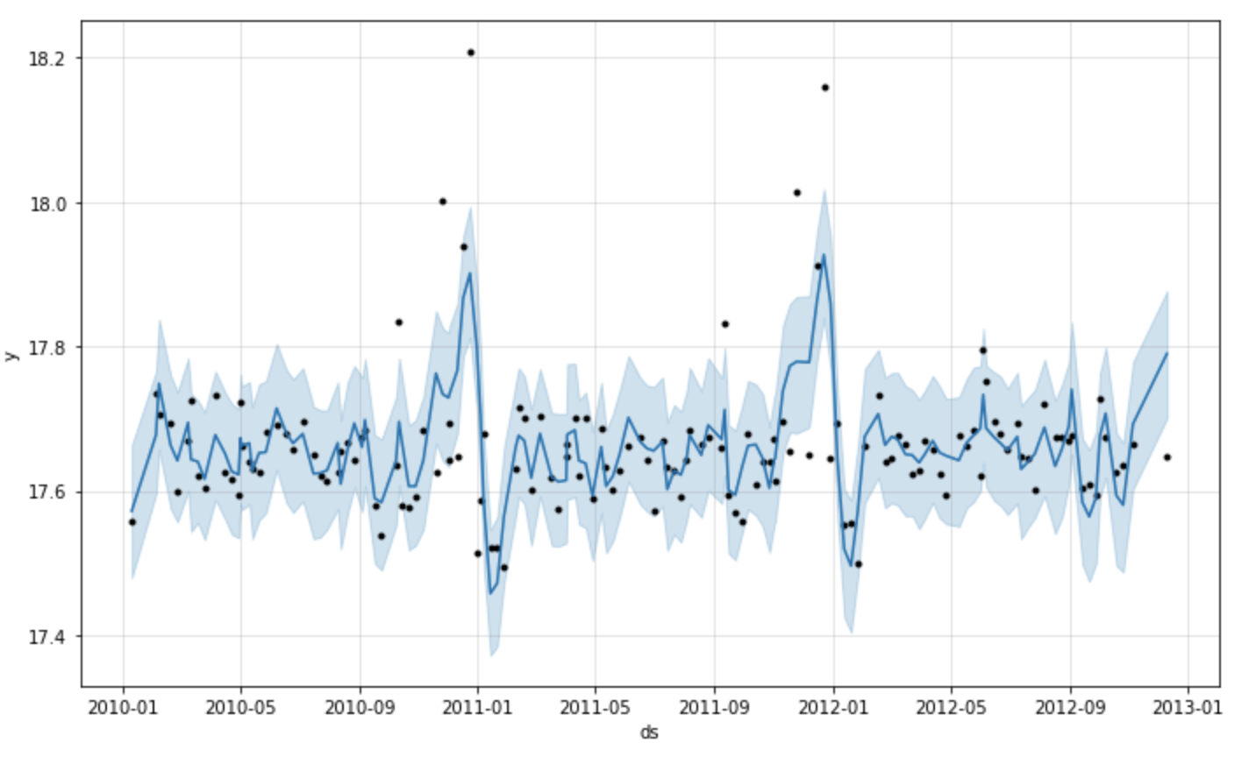
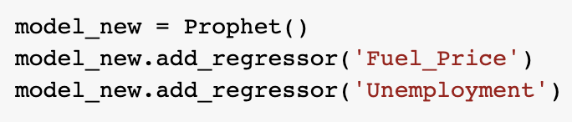
Time Series Models
Facebook Prophet
Multivariate Forecasting
RMSE : 3886002.06
RMSE : 3451591.611348
Notes:
5136942.16

Slide 20
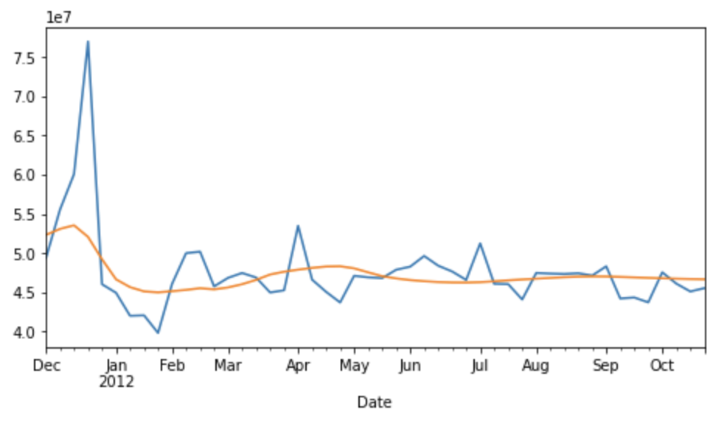
Time Series Algorithms
LSTM
RMSE : 5097790.39
Notes:
5136942.16

Slide 21
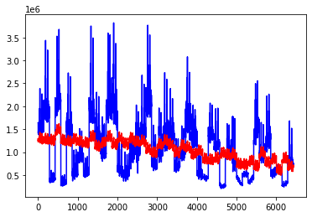
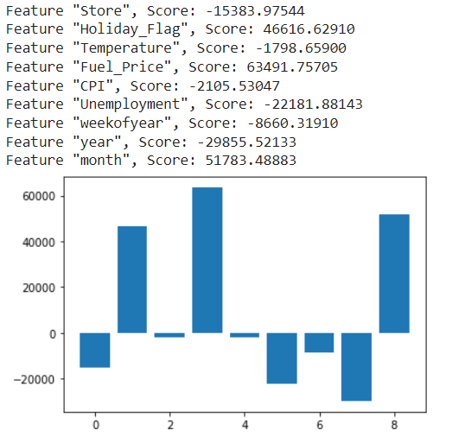
Regression Models
Multiple Linear Regression
Feature ‘‘Temperature’ and ‘CPI’ excluded:
RMSE : 527688.219704
Baseline Model:
RMSE : 520420.226516

Slide 22
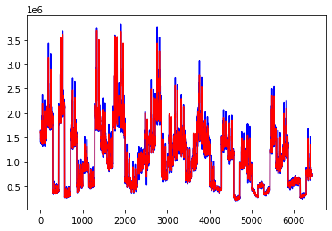
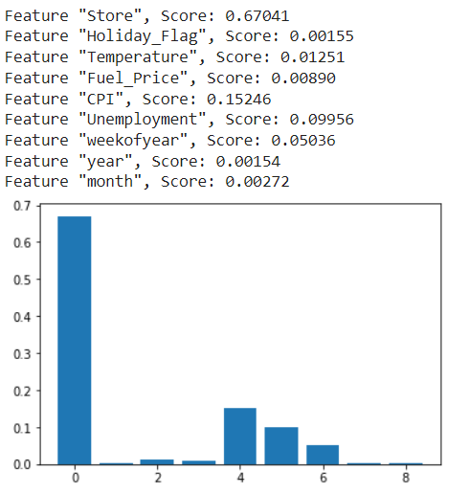
Regression Models
Random Forest Regression
Feature ‘Holiday_Flag’, ‘year’ and month excluded:
RMSE : 37682.047669
Baseline Model:
RMSE : 37682.047669

Slide 23
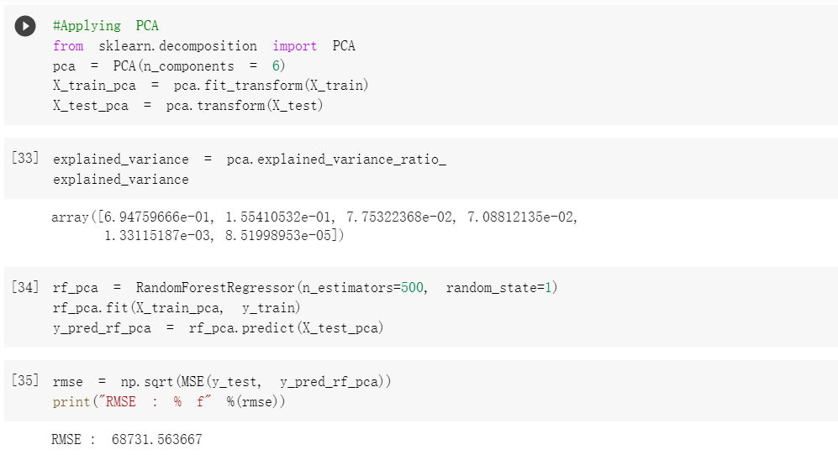

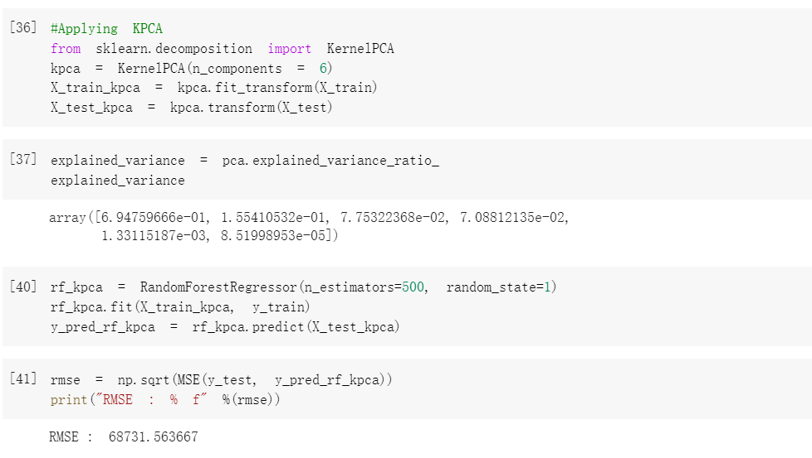
Dimentionarity Reduction
PCA
RMSE : 68731.563667
KPCA
RMSE : 68731.563667

Slide 24
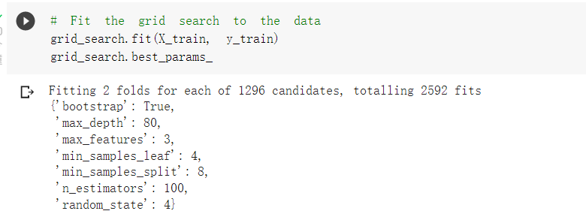
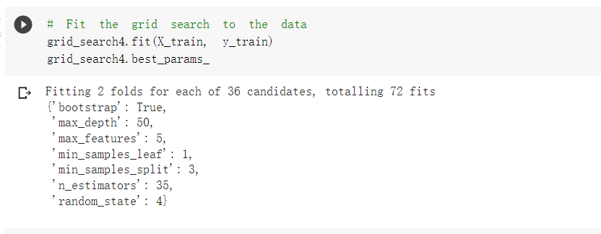
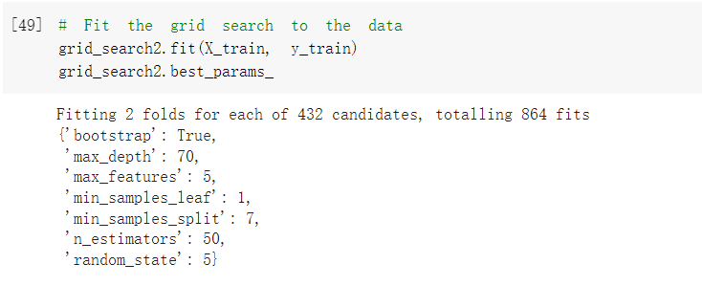
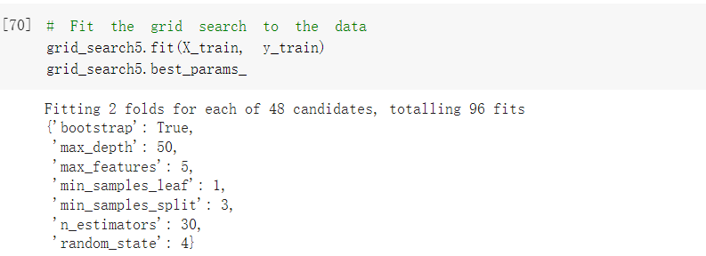
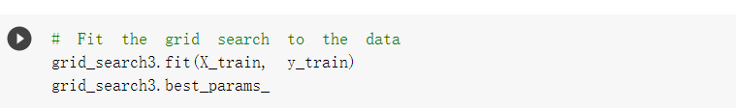

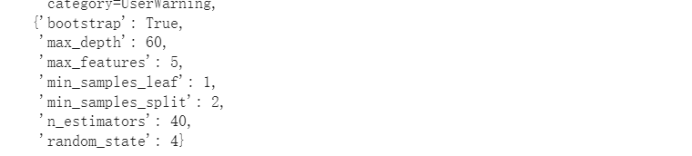
Hyperparameter Tuning
RMSE : 90392.538069
RMSE : 44146.195977
RMSE : 44040.803179
RMSE : 61737.736260
The baseline model performs the best among all these models.
RMSE : 40296.371264

Slide 25
05
Model Evaluation and Comparison

Slide 26
Model Evaluation and Comparison
Algorithm | Metrics
Linear Regression | RMSE : 520420.226516
Random Forest Regression | RMSE : 37682.047669
ARIMA | RMSE : 5136942.16
Facebook Prophet | RMSE : 3451591.61
LSTM | RMSE : 5097790.39
Notes:
5136942.16

Slide 27
06
Conclusion and Future Improvements

Slide 28
Conclusion and Future Improvements
Larger dataset for more accurate training
1
2
Compare with other algorithms such as Deep Learning algorithms
3
Apply the models to product-wise sales forecasting

Slide 29
Thank you!

